Slide 1
How To Disable Microsoft PowerApps Coauthoring
By CRMaaS Power Platform Admin Team
Dec 2025

Slide 2
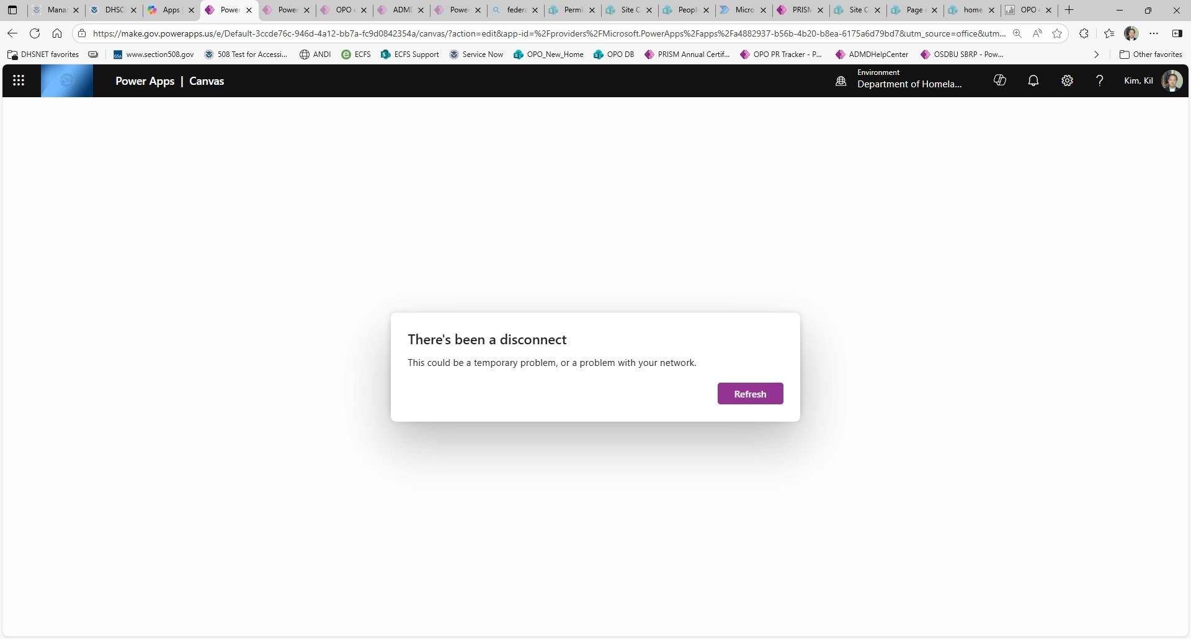
If a user see this error message below, coauthoring must be disabled.

Slide 3
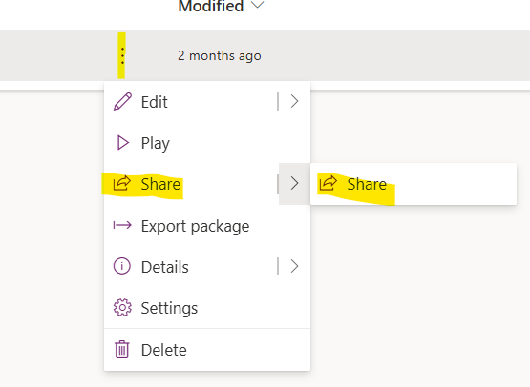
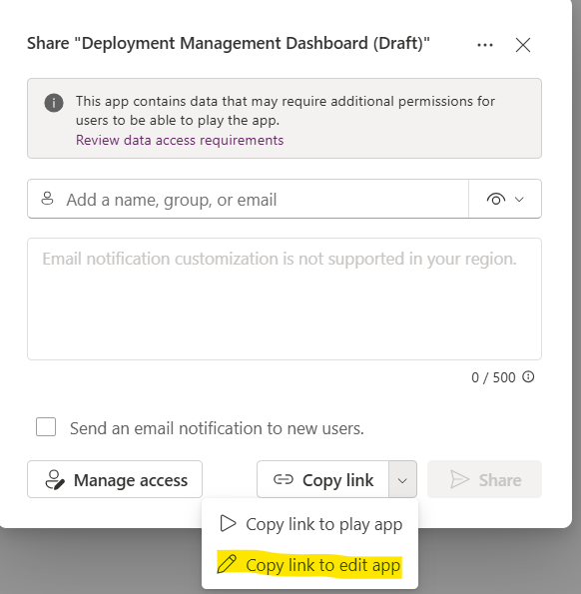
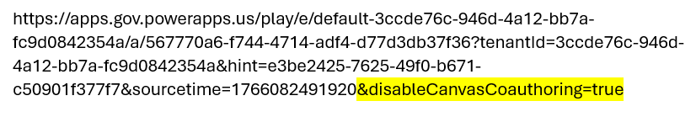
Disable Coauthoring in PowerApps
Follow the screenshots to get the “edit app” link.
From the PowerApps settings, click Share.
Copy link to edit app
Add the text command below to the end of the link as shown
&disableCanvasCoauthoring=true

